Slide 1

Response to Intervention in the Land of Orange
Presentation for Grade 9 RCR Students
September, 2019

Slide 2
What is RTIme?
Response to Intervention.
It is when specific help or support is provided to a student.
Teachers can “respond” to students’ needs when students can have a voice in what help they need.
So, we built 35 minutes per day into your schedule.
Over the course of a Semester, you have 40 hours of RTIme to use to be a better student! This is a gift!
You, the student, can choose where you need to go for extra support in your learning.

Slide 3
When is RTIme?
Period 1 9-9:55
10-10:35
Period 2 10:40-11:35
Period 3 11:40-12:35
Period 4 12:40-1:35
Period 5 1:40-2:35
Period 6 2:40-3:35

Slide 4
Why do we have RTIme?
We believe that students do better when they take some ownership of their own learning.
Students are self directing their own learning.
Everyone may need something different and have different questions about a lesson.
Our school’s motto is “Striving for Excellence” – RTIme gives you more power to do that.

Slide 5
How should you use RTIme?
To make up class time missed due to:
  Driver Training
  Illness
  Extra Curricular absences
Get homework done during the school day so you have time for a job, family, other activities.
Prepare for tests.
Get guidance from your actual teacher on challenging assignments.
Work in advance if you know you will be away.
You will need to use RTIme appropriately in order to access Relearning and Reassessing opportunities in your classes.

Slide 6
Where can you go during RTIme?
Any one of your classroom teachers’ rooms.
Any classroom that you wish to attend, even if you do not have that teacher.
Any of our “Open Spaces” that are available:
  Gym – a physical activity break may be what you need – keep it safe in the Gymnasium.
  Cafeteria – some students use this space for homework. Replace all chairs under the tables and keep it neat.
  Library – a great space for reading and homework. Please keep it quiet.

Slide 7
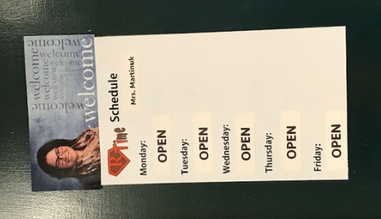
Teacher Schedules are posted a week at a time:

Slide 8
Keep a schedule
On the Grade 9 Induction Day, you did an activity adding events into a personal calendar (electronic or paper)
Take a picture of your teacher’s posted schedule.
Use your teachers’ posted schedules to plan in advance where you will go for RTIme each day.
If you have three tests or assignments in the span of a few days, you may find that you can’t get to all of the RTIme periods that you would like to get to. Plan ahead.

Slide 9
Exceptions:
Sometimes a teacher may be attending a PLC (Professional Learning Community) Meeting. It will be indicated on their posted schedule.
Once a month, usually on a Tuesday, we hold a M2W (Minute To Win It) RCR Activity during RTIme.
  September 13, we will do the Terry Fox Walk during RTIme.
Sometimes we hold a school-wide assembly during RTIme (Example Remembrance Day). Often the schedule is adjusted on these days.

Slide 10
Respecting quiet spaces
Keep hallways and Barry Sharpe Foyer quiet, please.
Get to your chosen RTIme spot within the first 5 minutes. (Just like the breaks between classes.)
Stay in your chosen spot until the end of RTIme.
You may go from one classroom to another (you may wish to go to Math first, then Health), but you must transfer quietly in the hallway.
Students don’t hang out in hallways, in bathrooms and changerooms, or on benches during RTIme.

Slide 11
Stay in the school during RTIme
The YRHS is an open campus during your lunch period, but not during RTIme.
We expect you to stay in the school during RTIme. Choose a classroom, the Gym, the Cafeteria, or the Library.

Slide 12
Self-directed versus School-directed
Students who are keeping up with their studies and homework and who are using RTIme properly may be self-directed during RTIme:
  You choose what appropriate areas to go to during RTIme.
Students who choose not to use RTIme properly and who may be behind in their studies will be school-directed for RTIme:
  A School Administrator or a Student Support Teacher may be assigning you to be in a certain spot during RTIme.

Slide 13
First RTIme for Grade 9 and 10 students!
Monday, September 9 will be your first RTIme!
Make a plan! Use your time wisely!
Be excellent!

